Slide 1

BUNS AGM 2024
Tuesday 16th April 6pm-7pm

Slide 2
Annual Report
Plans for the year
- increase membership
- ⁠do more outreach work with local schools/organisations
- ⁠work to make the uni as a whole more accessible
Plans for next year
- making neurodiversity everyone’s business
- ⁠continue to grow membership and diversity
- ⁠work on ongoing relationship with BGS
- ⁠Improve relationship with wellbeing service and resilife
- ⁠make a 5 year strategic plan to ensure longevity of the society

Slide 3
Annual report
Recruitment of members
How do membership numbers compare to last year?
96 members at the end of 22/23 - 125 now
How do social media follower number compare to last year?
130+ on WhatsApp at end of 22/23 - 80 now (members-only group)
475 IG followers at end of 22/23 - 644 now
Notes:
Refer to https://www.bristolsu.org.uk/support/tools-for-committees/managing-your-group under AGM then annual report

Slide 4
Annual Report
Events
What events have you run this year?
Weekly drop-ins with a range of different activities, some additional meet-ups, Inclusive Communities trip to aquarium.
What has been successful?
Last year's feedback was to have a wider range of activities and more additional meetups – we have done both of these! Even though we haven't had as many extra events as we hoped, we have managed to run a wider range of things, both for meet-ups and drop-ins.
Also honorary committee member Reggie is successful in everything he does.
Plans for future?
Hopefully more partnerships so we can run more trips, more meet-ups outside of the drop-ins as we haven't had as many as we hoped this year.

Slide 5
Annual Report
Financial report
Breakdown of income and expenditure
Outstanding loans or debts
Grants and funding awarded over the year
Sponsorships

Slide 6
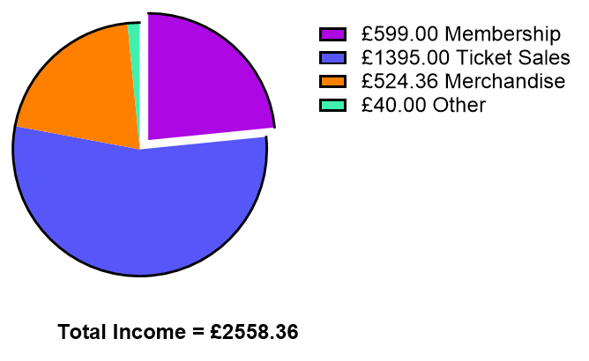
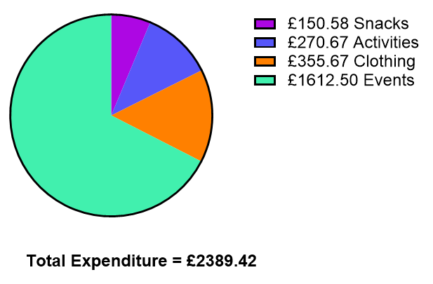
Annual Report
Financial report
Breakdown of income and expenditure

Slide 7
Annual Report
Equality, Diversity and Inclusivity Report
Snacks!
Open days, Transition Days and Welcome Week
Buddy Scheme
Resource List
Equality Action Plan
Committee resources
Plans for bigger and better things

Slide 8
Annual Report
Achievements
Ran Tuesday activities every week of the academic year!
Partnered with inclusive communities for an aquarium trip.
Gave extensive feedback to the SU and have secured regular contact with Thom Cornall to change our BUNS <->SU relationship for the future.
No injuries or need to call security/emergency services in BUNS sessions.
Consumed around 171 baked goods (+ 57(?) cupcakes to come...!)
Caused some neurodivergent havoc at: Botanic gardens, senate house, Mrs Potts, Christmas market, the aquarium, Richmond building, ZaZa Bazaar.
BUNS Ball on the 30th!

Slide 9
How motions work
Motions are read out by a member of the committee or the person who submitted them
Opportunity for members to speak if for/against
Voted via Menti – the code to vote will be read out, and a QR code will be shown
The motion will pass if 2/3 of members vote for it

Slide 10
How voting works
Each nominee will read out their manifesto/have someone read it
Once all nominations per role are done, opportunity for questions to be asked by members (related to role)
If questions are asked, they must be directed to ALL nominees
Voting via Mentimeter online according to first past the post-majority
Code to vote will be read out and a QR code will be shown
We can re-open nominations if enough people are not happy with the candidates

Slide 11
What happens next
24/25 committee group chat to be created
Begin handover process-
  meeting with all new committee
  individual meetings with old members and their counterparts
Complete reaffiliation

