Slide 1
Forgotten Heroes:
Discoveries by Black Scientists that Changed the World

Slide 2
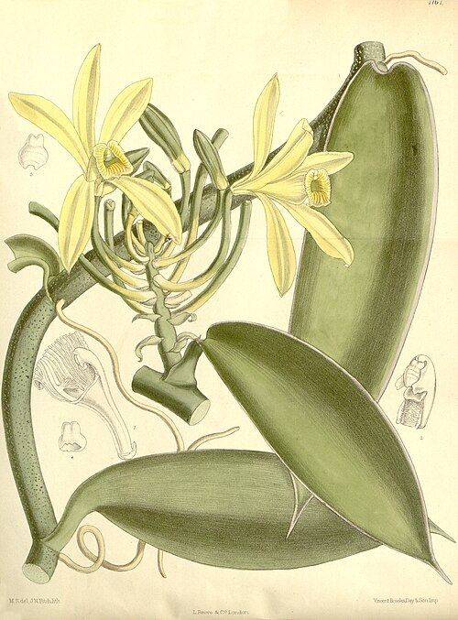
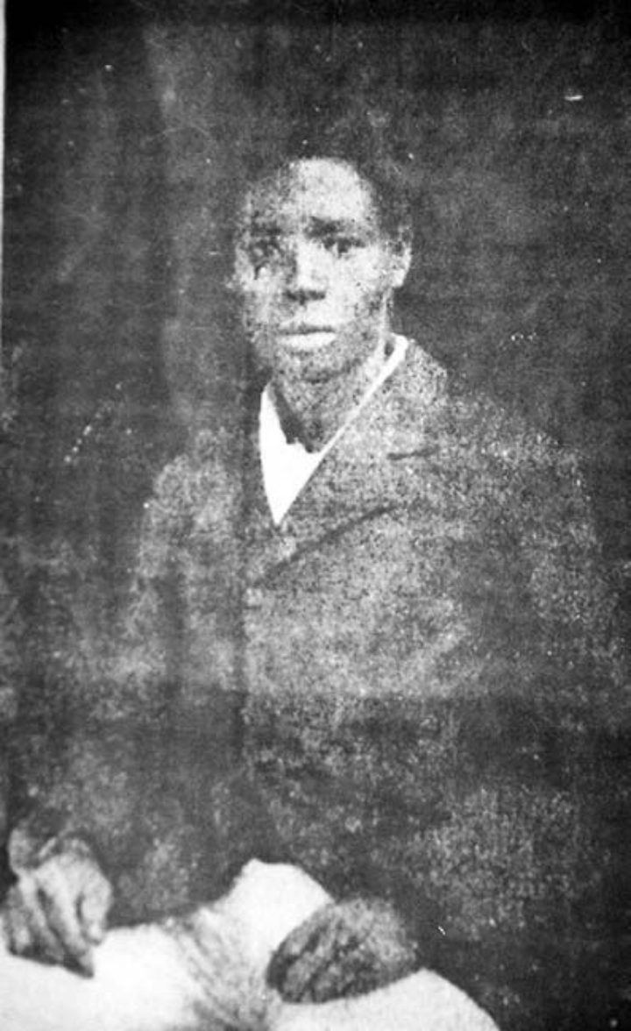
Edmond Albius
Horticulturist & botanist
1829 - 1880
During Edmond’s upbringing, it was not possible to produce commercial amounts of vanilla due to its inability to self-pollinate and the rarity of its natural pollinators.
At only 12 years old, Edmond was able to apply his knowledge of a method of hand-pollinating watermelon plants to hand-pollinate the vanilla plant.
Edmond’s technique allowed vanilla production to boom on the island (modern-day Réunion) and be shared across the globe.
He did not receive monetary recognition for his ingenious contribution during his lifetime, dying in poverty at 51.
Notes:
Picture: Wikimedia commons
Kull T, Arditti J, Wong SM. Orchid Biology: Reviews and Perspectives, X.; 2009. doi:10.1007/978-1-4020-8802-5

Slide 3
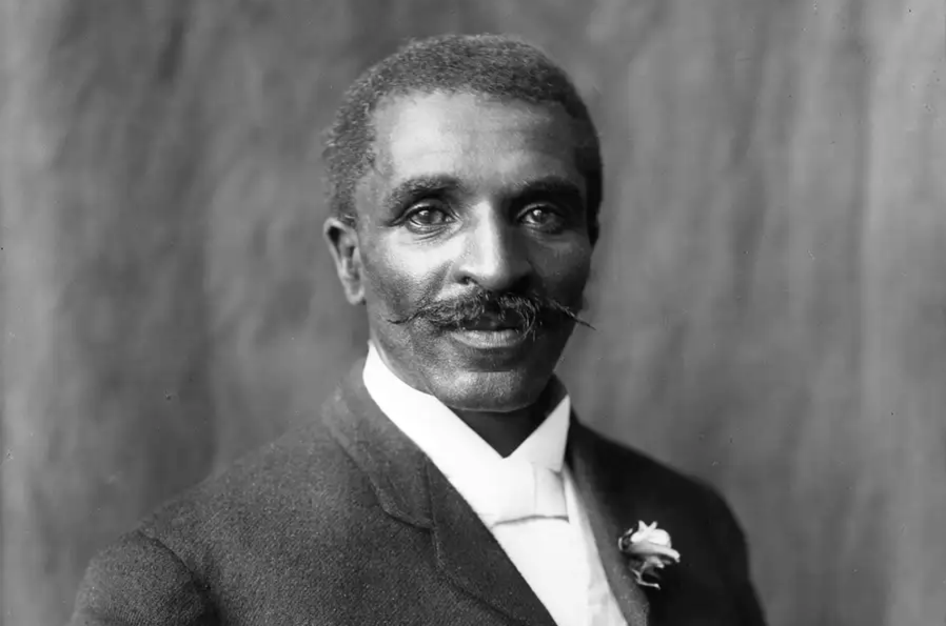
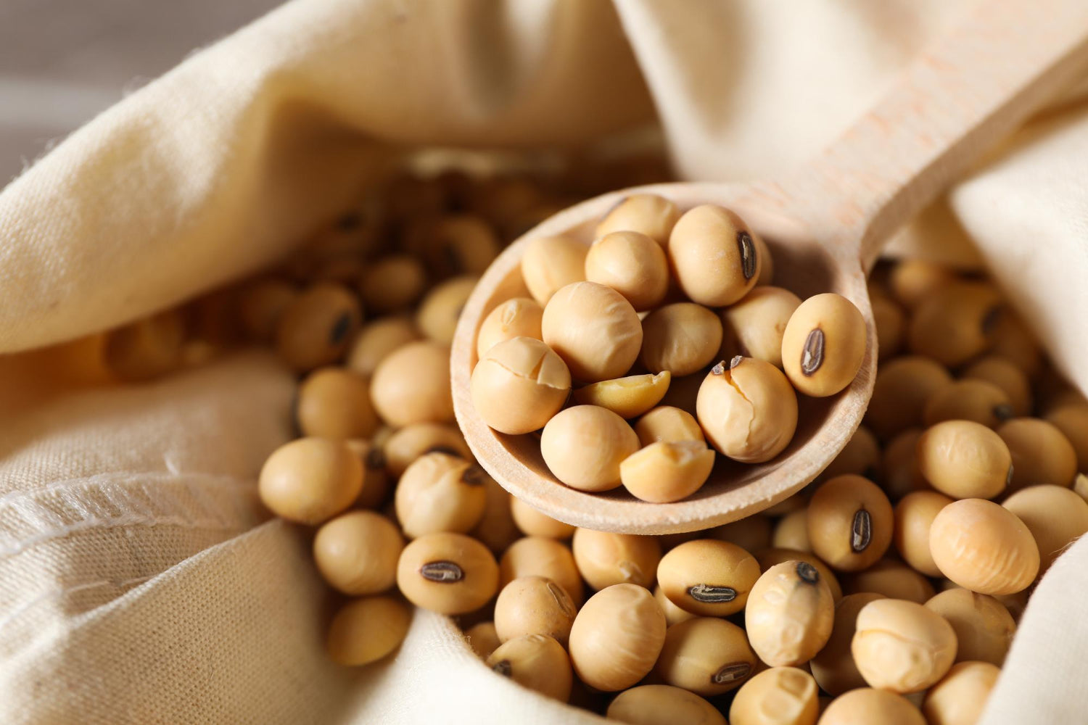
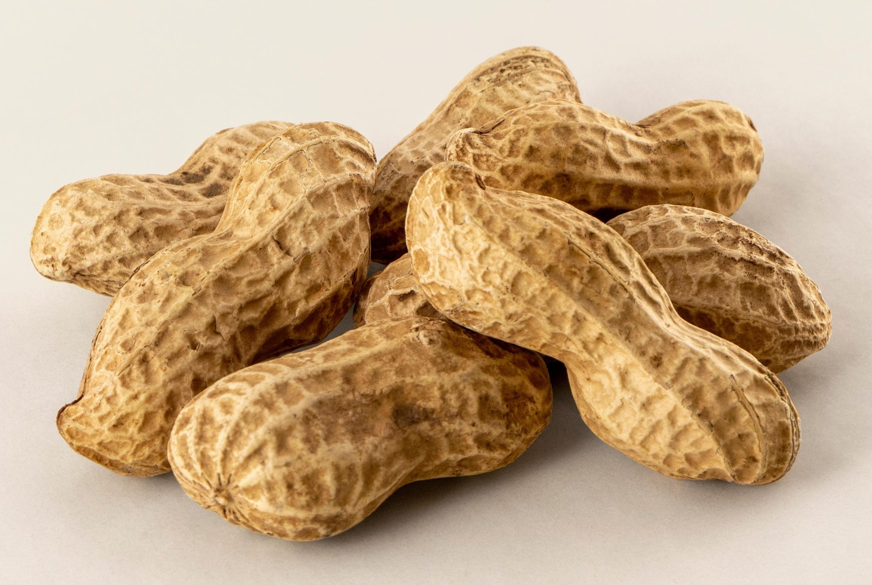
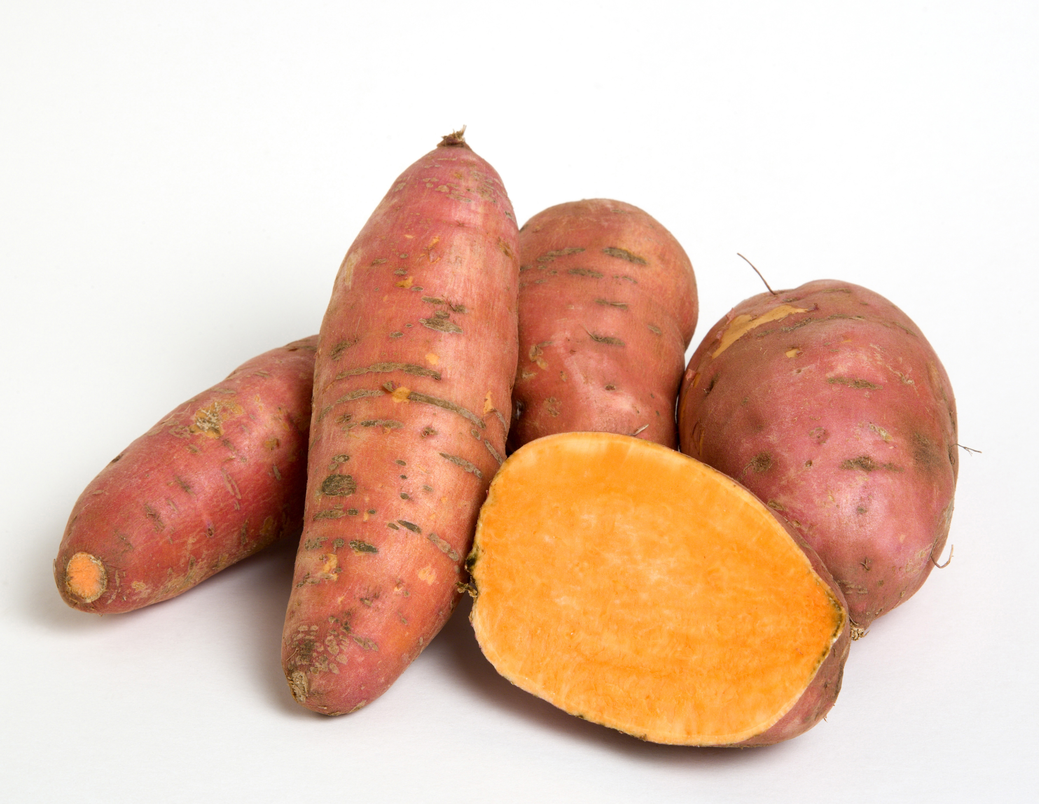
George Washington Carver
Agricultural scientist & inventor
1864 - 1943
Revolutionised farming in the American South.
Promoted crop rotation and introduced peanuts, sweet potatoes, and soybeans to restore soil fertility.
Developed hundreds of products from these crops, including dyes, plastics, and soaps.
Worked at Tuskegee Institute, advancing education and sustainability for rural communities.
Remembered as “The Peanut Man” and a pioneer in agricultural chemistry and environmental stewardship.
Notes:
“George Washington Carver.” Science History Institute. Available from: https://www.sciencehistory.org/education/scientific-biographies/george-washington-carver/. Accessed October 18, 2025.
“George Washington Carver.” Biography. Available from: https://www.biography.com/scientists/george-washington-carver. Accessed October 18, 2025.
Who was George Washington Carver? The Sun. February 11 2021. https://www.thesun.co.uk/news/13915147/george-washington-carver-inventor-scientist-jesup-wagon/. Accessed October 18 2025.
Stewart C. Elevate Your Plate: Recipes with Organic Soybeans. Be Still Farms – Healthy & Organic Living Blog. July 26 2023. https://be-still-farms.com/blogs/healthy-organic-living-blog/elevate-your-plate-recipes-with-organic-soybeans. Accessed October 18 2025.

Slide 4
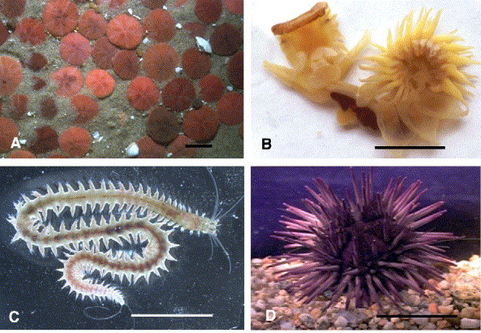
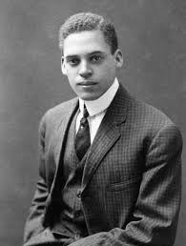
Ernest Everett Just
Biologist & educator
1883 - 1941
Celebrated for his careful studies of fertilisation, cell division and development of marine invertebrate eggs.
Championed studying cells in their natural environment, emphasising the role of the cell surface (cortex) and the “normality” of eggs in development.
Authored influential works such as Basic Methods for Experiments on Eggs of Marine Mammals (1922) and Biology of the Cell Surface (1939).
Despite racial barriers in the U.S., he gained international recognition and worked extensively in Europe, leaving a lasting legacy in cell biology and embryology.
Adult forms of marine invertebrates.
Notes:
Byrnes WM, Eckberg WR. Ernest Everett Just (1883–1941)—An early ecological developmental biologist. Dev Biol. 2006;296(1):1–11. doi:10.1016/j.ydbio.2006.04.445.
“Ernest Everett Just (1883-1941).” BlackPast.org. January 30, 2007. Accessed October 18, 2025.
“Ernest Everett Just.” Biography. Available from: https://www.biography.com/scientists/ernest-everett-just. Accessed October 18, 2025.

Slide 5
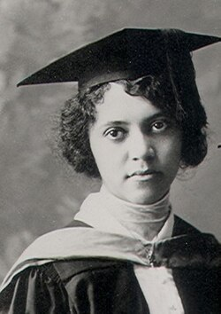
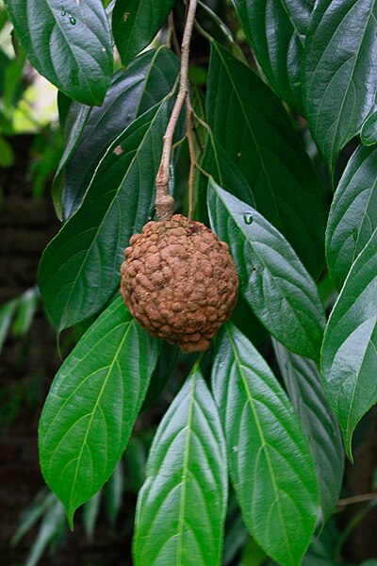
Alice Ball
Chemist
1892 - 1916
Revolutionised the first treatment for Leprosy, in the form of injectable chaulmoogra oil.
In 1916, she developed the "Ball Method" - improving bioavailability of the oil by extracting ethyl esters from the fatty acids, thus making it water-soluble.
Her research was published under her supervisor's name, as the "Dean Method”, after her death at the age of 24. Ball's contributions were not recognized until the year 2000.
As a result of her discoveries, 78 patients were discharged from Kalihi Hospital, on the island of Kalaupapa, where Leprosy victims were exiled to.
Notes:
Pajak, Bartosz. "Alice Ball: The Chemist Who Revolutionised Leprosy Treatment and Changed Pharmacological History". British Pharmacological Society. 29 Oct, 2024. www.bps.ac.uk/publishing/pharmacology-matters/october-2024/alice-ball-the-chemist-who-revolutionised-leprosy-. Accessed 19 October 2025.
Krichbaum, Emily. "Alice Ball". National Women's History Museum, 2025. https://www.womenshistory.org/education-resources/biographies/alice-ball. Accessed 19 October 2025.
Ackerley, Bethan. "Alice Ball". NewsScientist. www.newscientist.com/people/alice-ball/. Accessed 19 October 2025.

Slide 6
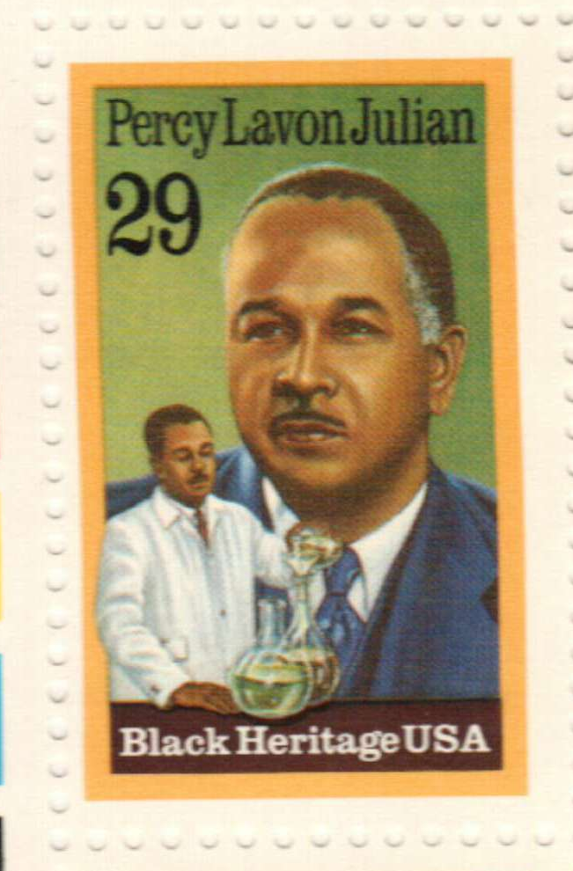
Percy L. Julian
Chemist
1899 - 1975
One of the first African Americans to receive a PhD in chemistry.
First person to synthesize the natural product physostigmine.
Held over 130 chemical patents.
Pioneered industrial-scale chemical synthesis of human hormones,
including progesterone and testosterone from plant sterols.
Helped develop treatments for birth control & fertility issues,
hormone therapies, pain relief, and rheumatoid arthritis.
Applied chemistry to everyday life by innovating fire-fighting foam
during WWII, paper coating, plywood glue, and water-based paints.
His legacy lives on through awards, schools, and buildings named after him, as well as recognition on stamps and in the National Inventors Hall of Fame.

Slide 7
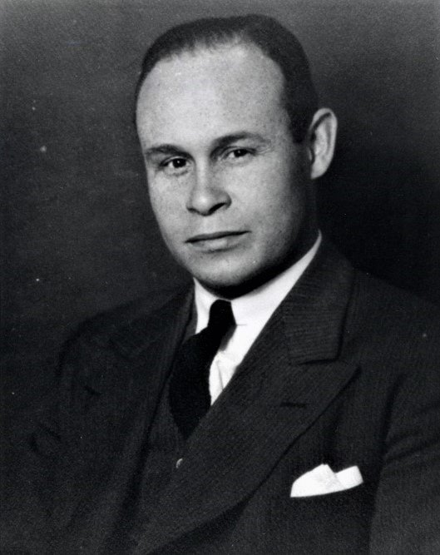
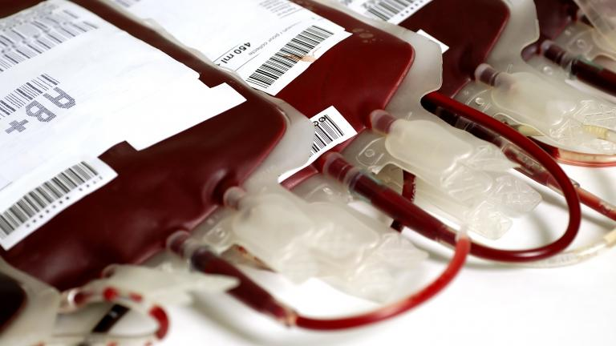
Charles R. Drew
‘Father of the Blood Bank’
1904 - 1950
Figured out that plasma could be stored longer than the rest of the components of blood and could be donated to any blood type.
Helped gather blood from American volunteers to send to British soldiers during WWII. Invented ‘bloodmobiles’, where people could donate in public spaces.
Could not donate his own blood due to racist policies enforced by the US government, which insisted on initially excluding, then segregating African American blood.
Spent the rest of his life training black medics
and campaigning for their better treatment.
Notes:
Pictures: By Associated Photographic Services, Inc - National Library of Medicine: http://profiles.nlm.nih.gov/ps/retrieve/ResourceMetadata/BGBBCT: Year supplied: ca. 1949Original Repository: Howard University. Moorland-Spingarn Research Center. Charles R. Drew Pap ; https://www.nhlbi.nih.gov/health/blood-bone-marrow-treatments
Info: https://bloodcancer.org.uk/news/charles-r-drew-the-father-of-the-blood-bank/

Slide 8
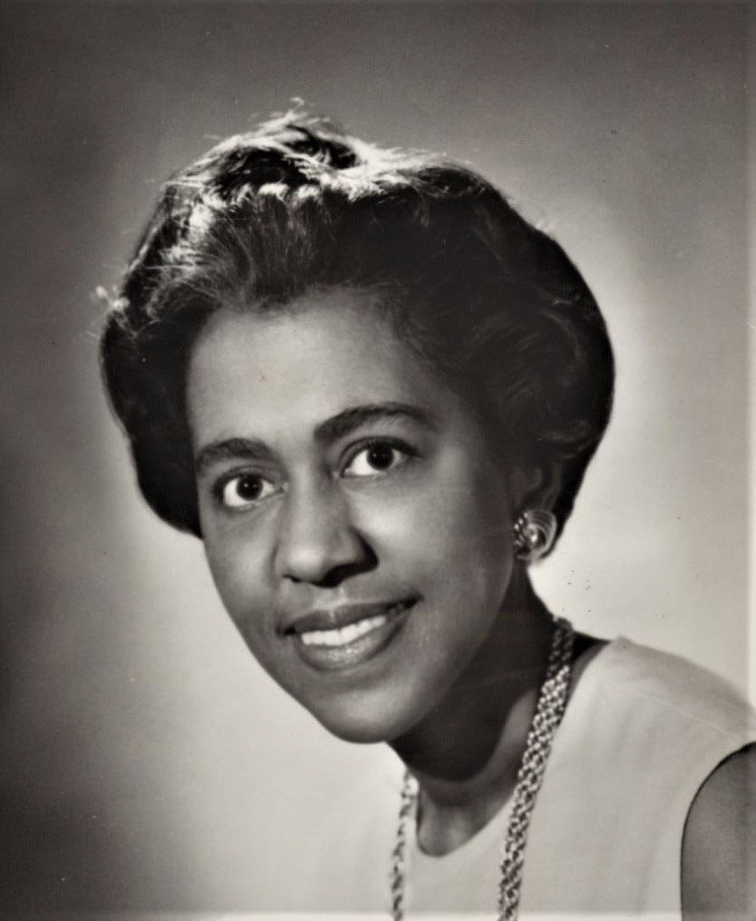
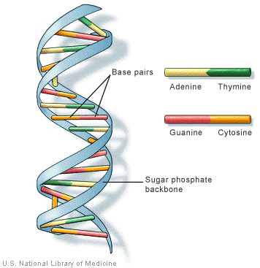
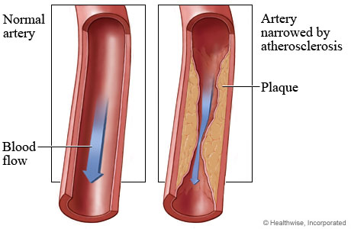
Marie Maynard Daly
Biochemist
1921 - 2003
Did groundbreaking work on cellular metabolism and the effects of diet on cardiovascular disease.
First African-American woman to earn a PhD in Chemistry in the US.
Identified hypertension as a risk factor for atherosclerosis, and the effect of high cholesterol on arteries.
Discovered the presence of lysine side-chains in histones, and the composition of nitrogenous bases in nucleic acids.
Worked alongside Alfred Mirsky and found that RNA is required for protein synthesis; this research was referenced in James Watson’s Nobel prize speech.
Notes:
Dubey, Anna. "Marie Maynard Daly". Encyclopedia Britannica, 2 Apr. 2025, www.britannica.com/biography/Marie-Maynard-Daly. Accessed 19 October 2025. Accessed 19 October 2025.
Kaplan, Judith. "Marie Maynard Daly". Science History Institute, 30 Apr. 2024./www.sciencehistory.org/education/scientific-biographies/marie-maynard-daly/. Accessed 19 October 2025.
Bruce, Victoria. "Marie Maynard Daly". American Chemical Society. www.acs.org/education/whatischemistry/landmarks/daly.html. Accessed 19 October 2025.

Slide 9
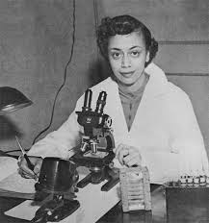
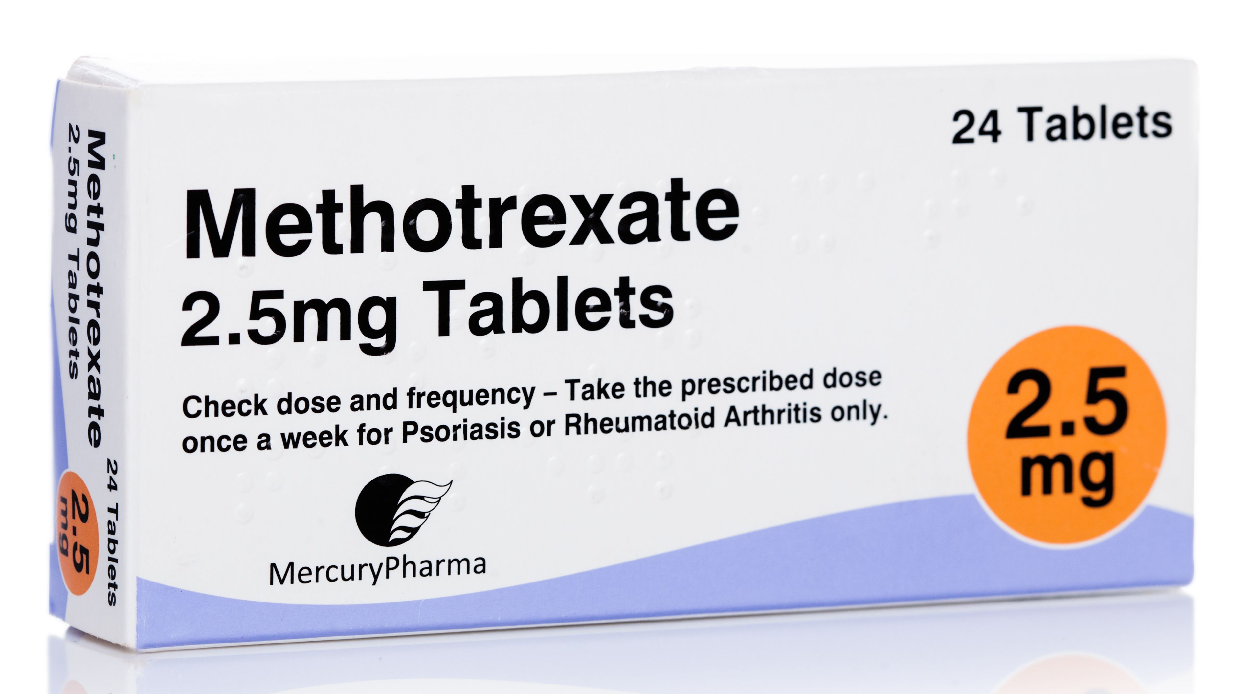
Jewel Plummer Cobb
Cell Biologist and Physiologist​
1924 - 2017
Described the effects of chemotherapeutic agents on melanoma through microscopy studies on human tissue culture.
Joined the faculty at the University of Illinois Medical College in 1952, where she taught cell physiology. Founded the university's first tissue culture laboratory so she could study melanoma.
​Cobb made a notable discovery alongside Jane Wright in the 1960s: methotrexate – a drug that slows cancerous cell growth – was effective in treating skin and lung cancers, as well as leukaemia.
After leaving the lab, Cobb immersed herself in teaching & leadership, becoming the first African American woman to be the President of California State University, Fullerton. Here she advocated for accessibility of science to women and minorities.

Slide 10
Discussion

Slide 11
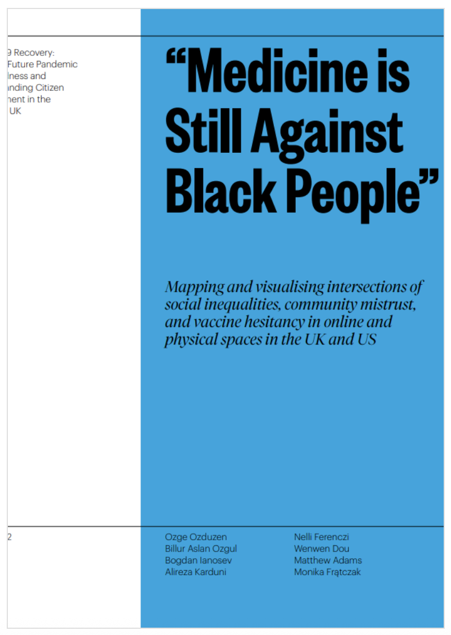
Overcoming implicit biases
“The report investigates social, cultural, and political factors underlying vaccine hesitant beliefs and ideas amongst minoritised communities in the United Kingdom (UK) and the United States of America (US).”
What do you think their findings were?
https://www.thebritishacademy.ac.uk/publications/medicine-is-still-against-black-people/

Slide 12
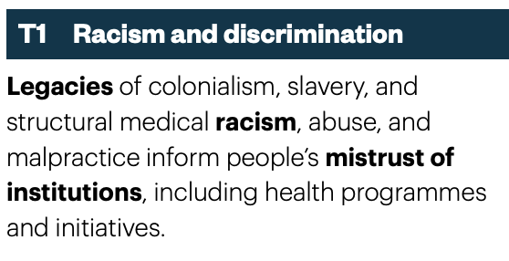
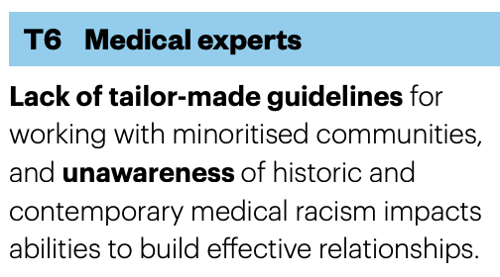
Lack of understanding, awareness & resources

Slide 13
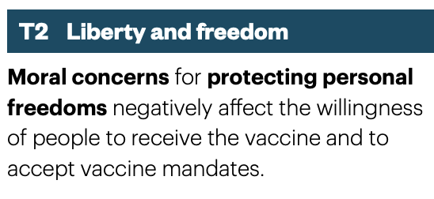
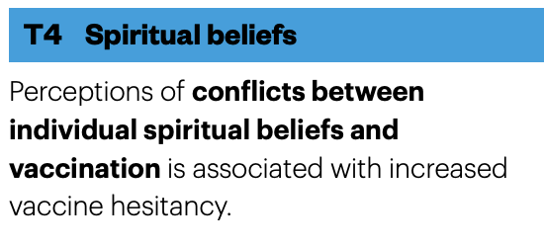
Personal perceptions and beliefs

Slide 14
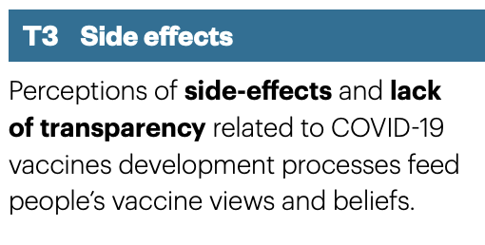
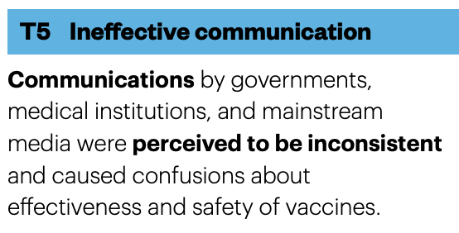
Lack of useful avenues for relaying information

Slide 15
Executive Summary
Prioritise building strong relationships between minoritised communities and healthcare institutions
Acknowledge the bias and discrimination within healthcare institutions and biomedical models of health.
Improve the way information and data are shared with publics
Acknowledge the agency and moral concerns of patients
Recognise the varied life experiences of vaccine-hesitant communities and avoid polarising discourse

Slide 16
Decolonising the curriculum - Qs
What do you understand by decolonising the curriculum?
What does a decolonised curriculum look like?

Slide 17
Decolonising the curriculum - Qs
What do you understand by inclusive teaching practices?
What are examples of inclusive and non-inclusive teaching practices that you have come across?

Slide 18
Decolonising the curriculum - Qs
Within your course, what could be improved in terms of inclusivity?

Slide 19

Decolonising the curriculum - resources
https://www.bristol.ac.uk/bilt/our-work-and-who-we-are/themes/decolonising-the-curriculum/
Student survey
Mythbusting- decolonising the curriculum (BILT blog)
Decolonising the Curriculum reading group
– first session 10/11 between 12:30 – 13:30; Book your ticket here

Slide 20
https://www.bristol.ac.uk/bilt/our-work-and-who-we-are/themes/decolonising-the-curriculum/subject-specific-resources/
Faculty of Life Sciences
Decolonisation of the curriculum – a conversation, Dr Katherine Haxton, Dr Neil Williams, Dr Caroline Garaway and Anne Kimunguyi - 2016 Staff Development Forum
#CommunicationSoWhite. Paula Chakravartty, Rachel Kuo, Victoria Grubbs, Charlton McIlwain - Journal of Communication, 2018. 68(2): p. 254-266.
Grappling with racism as foundational practice of science teaching. Manali J. Sheth - Science Education, 2009. 103: 37-60.
On reporting scientific and racial history. Rae Wynn-Grant - Science, 2019. Vol. 365, 6459, pp. 1256-1257
Superior: The Return of Race Science. Angela Saini 2019 - Charting the infiltration of Race Science into the mainstream
Decolonising the science curriculum in England: Bringing decolonial science and technology studies to secondary education. Haira Emanuela Gandolfi - 2021, British Educational Research Association Journal
Understanding our eugenic past to take steps towards scientific accountability. Rori Rohlfs - 2020, Genes to Genomes
The geography of publishing in the Anthropocene. Megan A. Hazlett, Kate M. Henderson, Ilana F. Zeitzer, Joshua A. Drew - Conservation Science and Practice, 2020. 2(10): p. 11.

Slide 21
Thanks for taking part!
We hope you enjoyed and learnt something new.

